Slide 1
Human Brain | Computer
Brain is constituted by neurons & synapses. | Can be constructed using IC, transistors, diodes, capacitors, and transistors.
The memory growth of a brain increases every time synaptic links are connected. | The memory growth of the computer can be increased by adding memory chips
Brain has a memory power of about 100 teraflops (approx. 100 trillion calculations/seconds) | Computer has a memory power of about 100 million megabytes.
The memory density of the brain is 10⁷ circuits/cm³. | Computer has a memory density of 10¹⁴ bits/cm³ .
The energy consumption is 12 watts of power. | The energy consumption is in terms of gigawatts of power.
The information is stored as electrochemical and electric impulses. | The information is stored in numeric and symbolic form (as in binary bits).
The information is transmitted using chemicals that fire the action potential in the neurons. | The communication happens using electrical coded signals.
The input or output equipment is the sensory organs. | The input and/or output equipment includes keyboards, mouse, web cameras.
Brain implements massive amounts of parallelism. | Computer has limited parallelism.

Slide 2
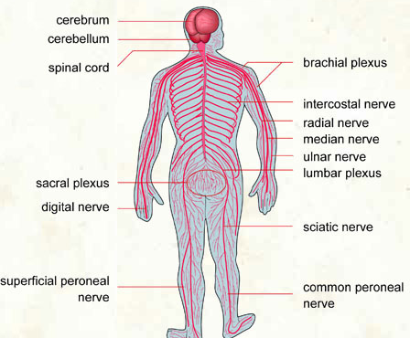
What is the nervous system?
The nervous system consists of two divisions: the Central Nervous System containing the brain and spinal cord, and the Peripheral Nervous System which is a network of nerves and neural tissues branching out throughout the body.

Slide 3
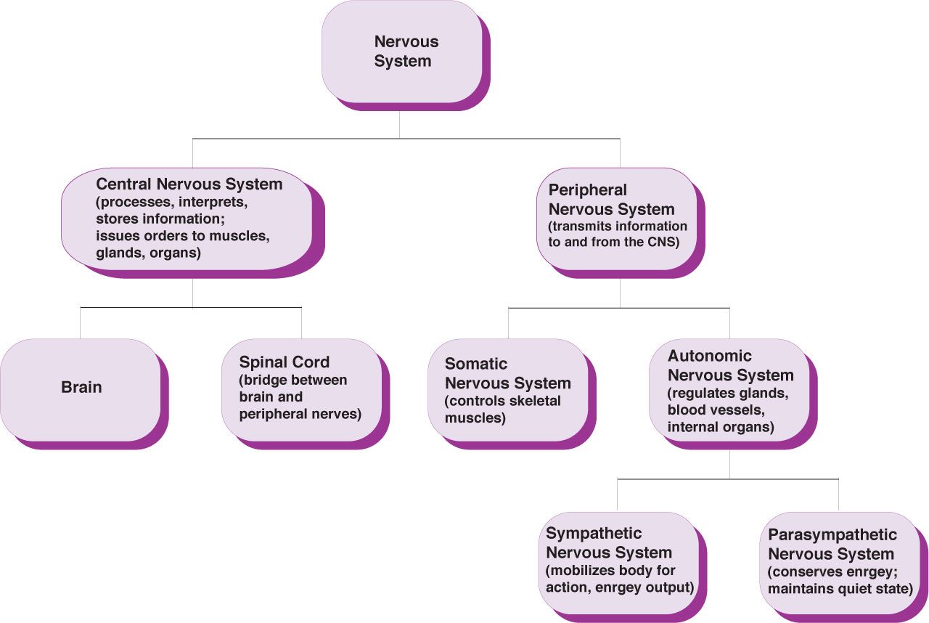
Organization of the nervous system

Slide 4
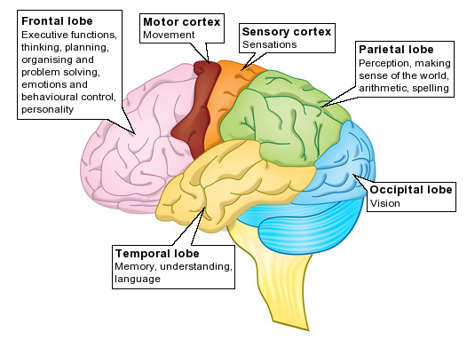

Slide 5
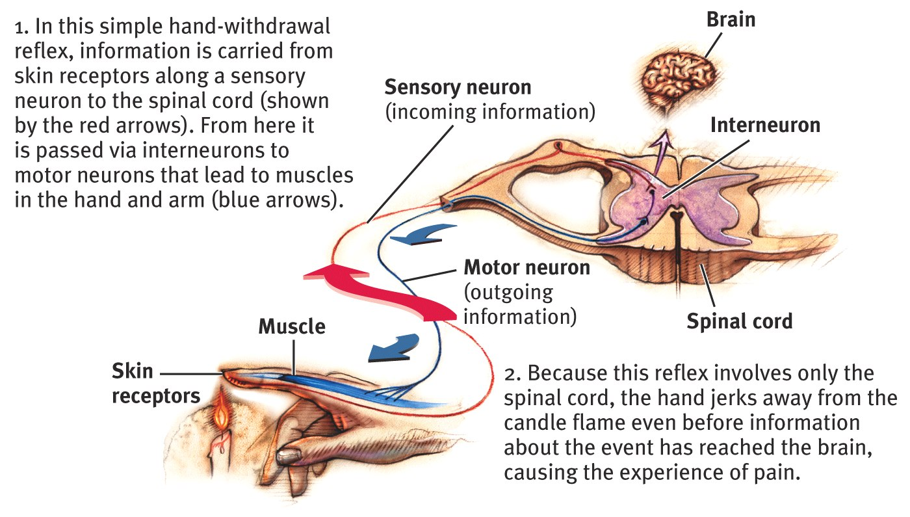
Central Nervous System – The Spinal Cord and Reflexes

Slide 6
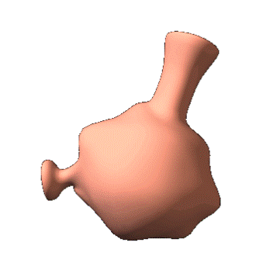
Divisions of the Peripheral Nervous System
Nerves consist of neural “cables” containing many axons.
They are part of the peripheral nervous system and connect muscles, glands, and sense organs to the central nervous system.
There are two divisions of the peripheral nervous system:
the somatic, or voluntary portion
the autonomic, or involuntary portion
Somatic Nervous System: The division of the peripheral nervous system that controls the body’s skeletal muscles (voluntary).
Autonomic Nervous System: Part of the PNS that controls the glands and other muscles (involuntary).

Slide 7

Autonomic Nervous System (ANS)
The autonomic portion of the peripheral nervous system governs involuntary, visceral functions…such as heart and breathing rate, blood pressure, etc.
It is divided into two systems:
Sympathetic Nervous System: Division of the ANS that arouses the body, mobilizing its energy in stressful situations.
Parasympathetic Nervous System: Division of the ANS that calms the body, conserving its energy.

Slide 8
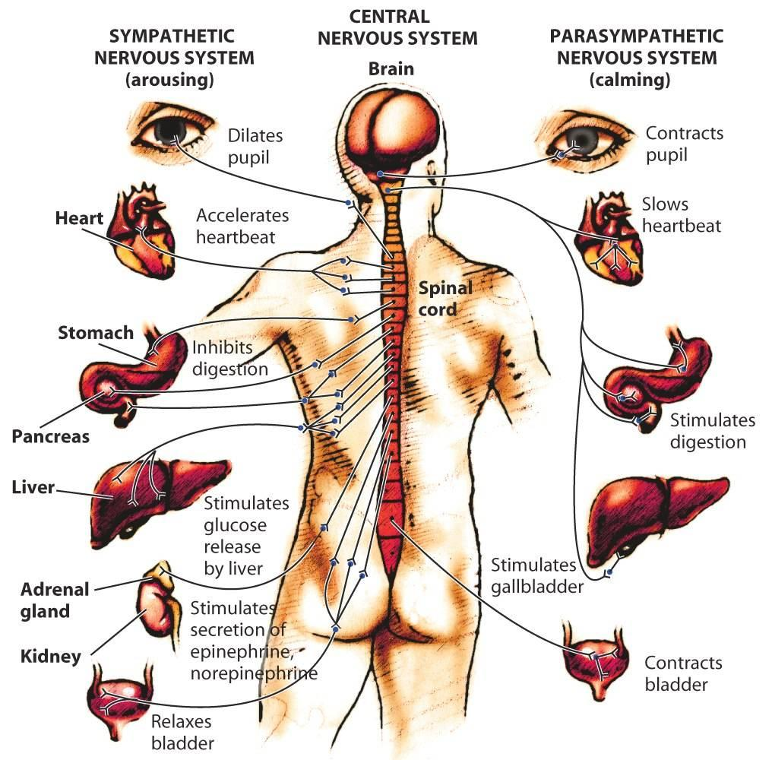
The Parasympathetic Nervous System
Activates processes that conserve bodily resources… slowing heart rate, reducing blood pressure, etc.
“Calms”
(rest and digest)

Slide 9
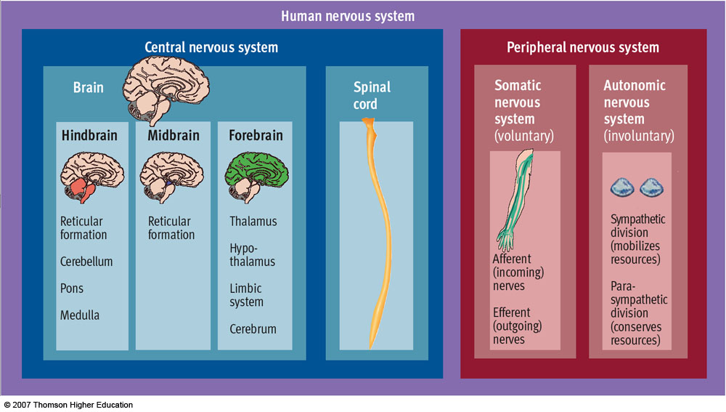
Recap

Slide 10
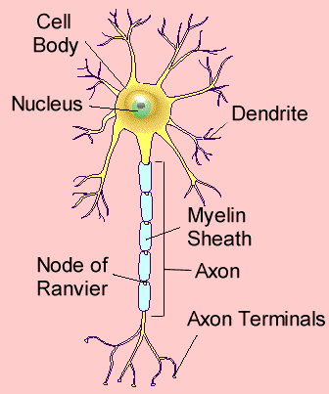
Types of neurons…
The motor neurons usually have one axon and several dendrites.
The axon is covered with a insulating fatty layer called a myelin sheath, and transmits signals a long distance from the neuron to the area to be activated.
Dendrites are short and unsheathed.
Motor neurons cause muscle contractions and control secretions from glands and organs… controlling body functions.

Slide 11
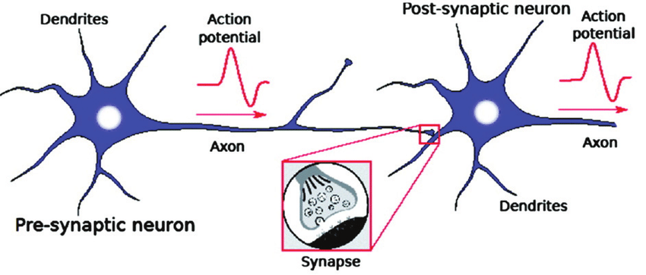

Slide 12
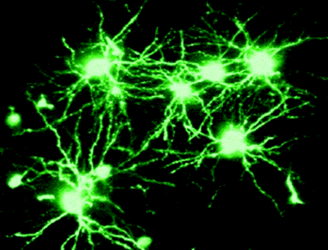
Synapses…
Nerve impulses are transmitted via branches called synapses. The synapses are connectors… hooking dendrites and axons from one neuron to another.
The number of synapses influences transmission. That number can decrease with disease, lack of stimulation, drug use, etc.

Slide 13
Parts of the brain…the cerebrum
Taking up 7/8ths of the brain’s weight, the cerebrum governs all sensory and motor activity.
Includes sensory perception, emotions, consciousness, memory, and voluntary movements.
It is divided into the left and right hemispheres.
The surface or cortex is arranged in bulging folds, each one called a gyrus , and furrows, each one called a sulcus

Slide 14
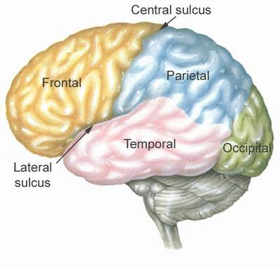
Parts of the brain…the cerebrum
The cortex is also divided into 4 lobes that correspond to the overlying bones of the skull: the frontal lobe specializes in motor activity, personality, and speech; the parietal lobe is where language, temperature, pressure, touch are interpreted;
Temporal lobe contains centers for hearing, smell, and language input; the occipital lobe specializes in vision.

Slide 15
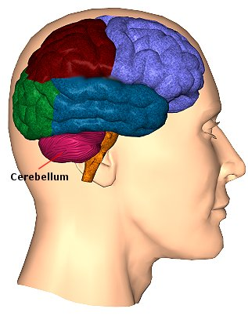
Parts of the brain…the cerebellum
The cerebellum is the second largest part of the brain. It contains nerve fibers that connect it to every part of the central nervous system. It coordinates voluntary and involuntary patterns of movements. It also adjusts muscles to automatically maintain posture.

Slide 16
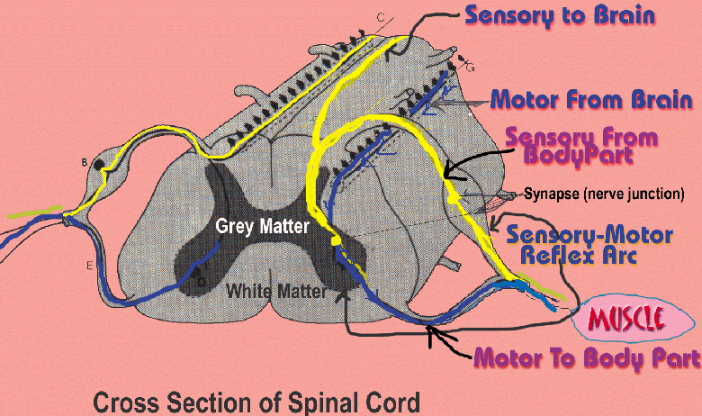
The spinal cord…
At each segment of the spinal cord, left and right pairs of sensory and motor nerves branch out and connect to the peripheral nervous system. Impulses travel back and forth to the brain and back to the muscles.

Slide 17
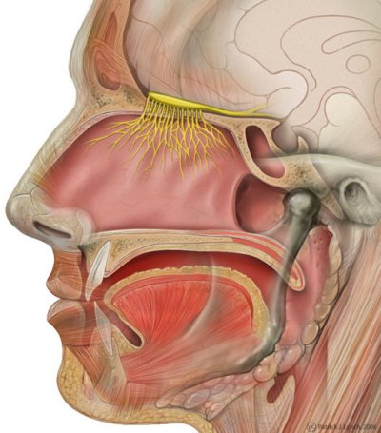
Peripheral nervous system…
The network of nerves branching out throughout the body from the brain and spinal cord is called the peripheral nervous system.
In addition to the 31 pairs of spinal nerves on the spinal cord, there are 12 pairs of cranial nerves that attach to the brain:
Eg I:The olfactory nerve carries sensory input for smell

Slide 18
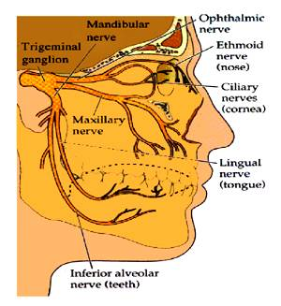
Peripheral nervous system…
II. The optic nerve carries sensory input for vision
III. The oculomotor nerve controls muscles of the eye and eyelid
IV. The trochlear nerve controls the eyeball
V. The trigeminal nerve controls the face, nose, mouth, forehead, top of head, and jaw.
VI. The abducens nerve also controls the eyeball

Slide 19
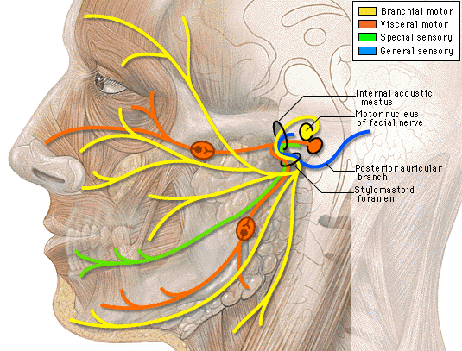
Peripheral nervous system…
VII. The facial nerve
controls muscles
of the face and
scalp, and part of
the tongue for
sense of taste.
The auditory or
cochlear nerve
provides sensory
input for hearing and equilibrium.
IX. The glossopharyngeal nerve controls saliva, swallowing, and taste.

Slide 20
Cell Membrane Potential
A cell membrane is usually polarized, with an excess of negative charges on the inside of the membrane; polarization is important to the conduction of nerve impulses
A. Distribution of Ions
The distribution of ions is determined by the membrane channel proteins that are selective for certain ions.
Potassium ions pass through the membrane more readily than do sodium ions, making potassium ions a major contributor to membrane polarization.

Slide 21
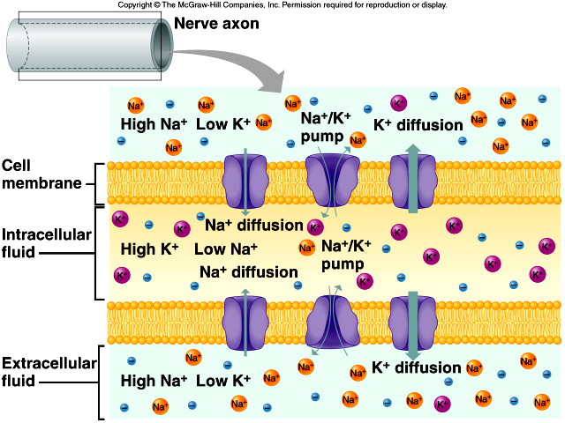
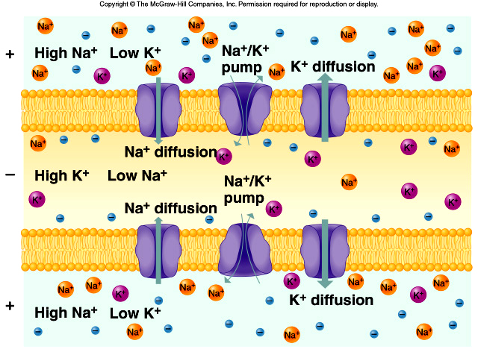
B. Resting Potential
1. Due to active transport, the cell maintains a greater concentration of sodium ions outside and a greater concentration of potassium ions inside the membrane.
2.The inside of the membrane has excess negative charges, while the outside has more positive charges.
3. This separation of charge, or potential difference, is called the resting potential (-70mV)

Slide 22
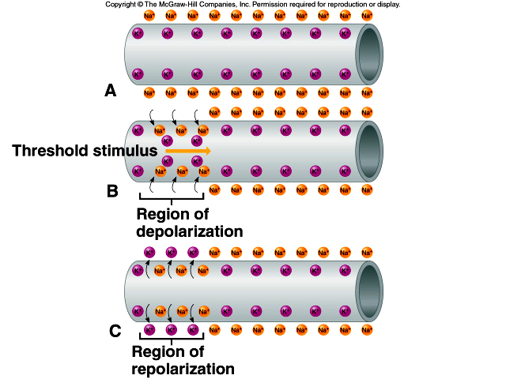
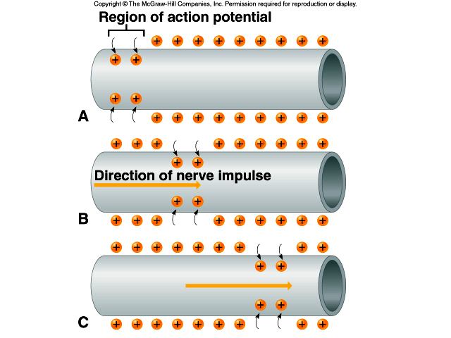
C. Potential Changes
1. When the membrane potential becomes less negative(-55mV), the membrane is depolarized.
2. If sufficiently strong depolarization occurs, a threshold potential is achieved as ion channels open.
3. At threshold,(+30mV) action potential is reached.
4. Action potential may be reached when a series of subthreshold stimuli summate and reach threshold.

Slide 23
D. Action Potential
At threshold potential, membrane permeability to sodium suddenly changes in the region of stimulation.
As sodium channels open, sodium ions rush in, and the membrane potential changes and becomes depolarized.
At the same time, potassium channels open to allow potassium ions to leave the cell, the membrane becomes repolarized, and resting potential is reestablished.
This rapid sequence of events is the action potential.
The active transport mechanism then works to maintain the original concentrations of sodium and Potassium ions.
A nerve impulse is conducted as action potential is reached at the trigger zone and spreads by a local current flowing down the fiber, and adjacent areas of the membrane reach action potential.

Slide 24
Does the human brain operate as an analog system, or a digital one?
The answer is “both”.
On the one hand, a neuron either does or does not transmit an action potential.
This is an “all-or-nothing” process, and in this sense, the brain operates digitally.
But the frequency at which a neuron transmits action potentials can vary continuously, thus giving it this property of an analog system as well.

Slide 25
Deterministic versus non-deterministic
Computers are deterministic machines in the sense that with a given input, they will always produce the same output. Computers can simulate non-deterministic systems by introducing pseudo-random variables.
Computers can also apply equations from chaos physics , in which the results of deterministic processes can be greatly influenced by tiny variations in the initial conditions.
The brain is considered a non-deterministic system: that it is never completely the same from one moment to the next.
It is constantly forming new synapses and strengthening or weakening existing ones according to how they are being used. Consequently, a given input will never produce exactly the same output twice.

Slide 26
Limitations of the brain
More generally, three essential bottlenecks were shown to limit information processes in the brain: the Attentional Blink (AB) limits our ability to consciously perceive,
The Visual Short-Term Memory (VSTM) our capacity to hold in mind, and
The Psychological Refractory Period (PRP) our ability to act upon the visual world. In particular, the brain takes up to 100 ms to process complex images

Slide 27
Electro Encephalogram (EEG)
A test that measures electrical activity in the brain using small, metal discs (electrodes) attached to the scalp.
Brain cells communicate via electrical impulses and are active all the time, even during asleep.
It may also be made from electrodes placed directly over the surface of the brain or from needle electrodes inserted into the brain.
The architecture of the brain is not uniform but varies with different locations. Thus the EEG can vary depending on the location of the recording electrodes.

Slide 28
Alpha waves - frequencies between 8 - 13 Hz with amplitude less than 10 µV. Found people who are awake and resting quietly, not in intense mental activity
Beta waves -frequency 14 to 22 Hz, upto 50 Hz under intense mental activity. two types: beta I waves, lower frequencies which disappear during mental activity, and beta II waves, higher frequencies which appear during tension and intense mental activity.
Gamma waves :22 -30 Hz with an amplitude of less than 2 µV peak-to-peak and are found when the subject is paying attention or is having some other sensory stimulation.
Theta waves: freq 4 to 7 Hz with an amplitude of less than 100 µV. They occur mainly in the parietal and temporal regions in sleep and also in children when awake, and during emotional stress in some adults, particularly during disappointment and frustration. Sudden removal of something causing pleasure will cause about 20 s of theta waves.
Delta Waves (Up to 4 Hz)are high-amplitude brain waves and are associated with deep sleep stages.

Slide 29
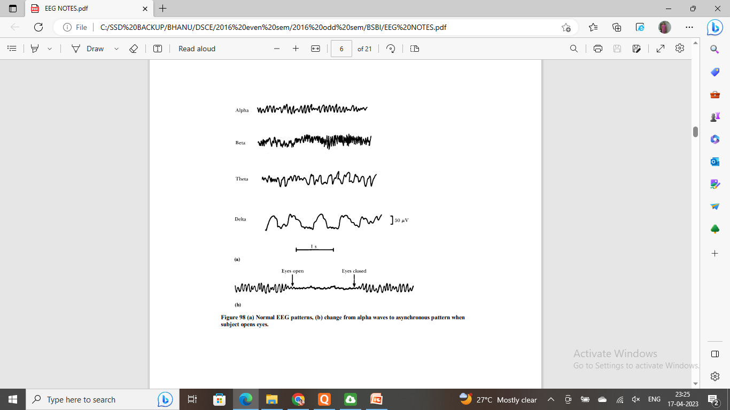
Brain waves in EEG

Slide 30
Applications of EEG
Diagnosis of epilepsy
2. Localization of brain tumour
3.Dementia (Memory problems)
4.Head injury
5. Psychological disorder

Slide 31

Robotics in prosthetic limbs
Robotic prosthetic limb is a well-established research area that integrates advanced mechatronics, intelligent sensing, and control for achieving higher order lost sensory motor functions while maintaining the physical appearance of amputated limb.
Example: an under actuated robot with 15 degrees of freedom and can achieve five grasping patterns: power grasp, tip grasp, lateral grasp, hook grasp, and index point.
Can achieve required hand preshaping for a given grasping pattern using electric-power in the pregrasp stage and body power is used in grasp stage to execute the final grasping action.

Slide 32
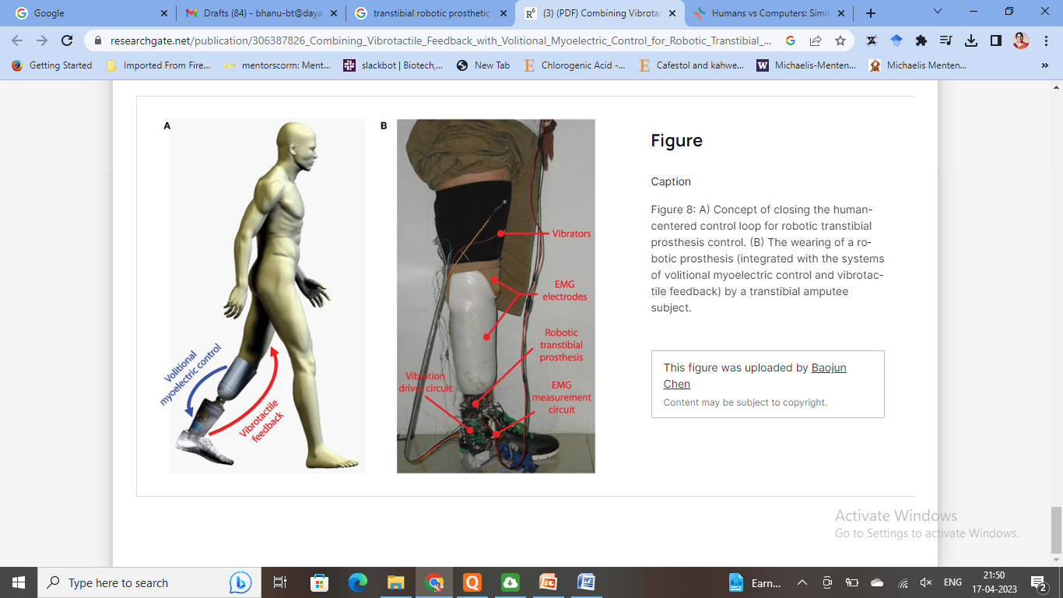
Transtibial robotic prosthetic limb
A powered biarticular transtibial prosthesis, which is a combination of a commercial powered ankle-foot prosthesis and a motorized robotic knee orthosis.
The orthosis is controlled to imitate the human gastrocnemius based on neuromuscular models of matched non-amputees.
Gastrocnemius muscle is a complex muscle that is fundamental for walking and posture. It forms the major bulk at the back of lower leg and is a very powerful muscle.

Slide 33
Types of Limb control
Lower limb impedance control:
Used to control the dynamic interactions between the environment and a manipulator.
Works by treating the environment as an admittance and the manipulator as the impedance.
This translates into the torque required at each joint during a single stride,
represented as a series of passive impedance functions piece wise connected over a gait cycle.

Slide 34
Myoelectric control:
Electromyography (EMG) is a technique used for evaluating and recording the electrical activity produced by skeletal muscles.
Advanced pattern recognition algorithms can take these recordings and decode the unique EMG signal patterns generated by muscles during specific movements

Slide 35
Speed-adaptation mechanism:
The speed-adaption mechanism is a mechanism used to determine the required torque from the joints at different moving speeds.
During the stance phase it has been seen that quasi- stiffness, which is the derivative of the torque angle relationship with respect the angle, changes constantly as a function of walking speed

Slide 36
Upcoming research
implanted electrodes (neural, intramuscular and epymisial electrodes) to record neural or muscle activity;
pressure sensor matrices to detect force changes during muscle contraction;
the myokinetic approach to measure muscle deformation.
Aims at measuring muscle deformation during contraction instead of muscle electrical activity. A novel approach based on sensing the magnetic field of permanent magnets directly implanted into residual muscles

Slide 37
Engineering solutions for Parkinsons disease
PDis a neurodegenerative disease that affects parts of the brain that control the movement of muscles, and can result in the person having ‘shakes’ or tremors and experience difficulty walking and speaking.
The neurological condition affects parts of the brain that help us to control our movements, and this means that people with Parkinson’s disease typically develop tremors or ‘shakes’, they may stoop, sway, fall.
They may have trouble speaking clearly and their muscles may ‘freeze’ when they want to walk.
When medicines no longer control the tremors or gait ‘freezing’- one treatment option to manage symptoms is Deep Brain Stimulation (DBS)
This involves surgically implanting an electrode into an affected brain region.
The electrode is powered by a battery, which is in turn implanted into the person’s chest cavity, and the electrode delivers small electrical pulses or stimuli to brain cells which are involved in the control of muscles.

Slide 38
A Closed Loop Computer Model of the entire neuromuscular system which captures the electrode in DBS and how it affects surrounding brain tissue and the muscles it controls
Simulation pathways on the models and by taking measurements from healthy volunteers and people with PD.
The Personal KinetiGraph is a wearable device that collects data on a patient’s movement, providing information -such as tremors, slow or involuntary movements and immobility – to a patient’s doctor, which reduces the cost of a visit.
Web application able to detect early warning signs of PD: Users upload a video recording of certain tasks.AI software then combines machine learning and computer vision techniques to identify and track the movements in various joints, comparing them with known Parkinson’s symptoms.

Slide 39
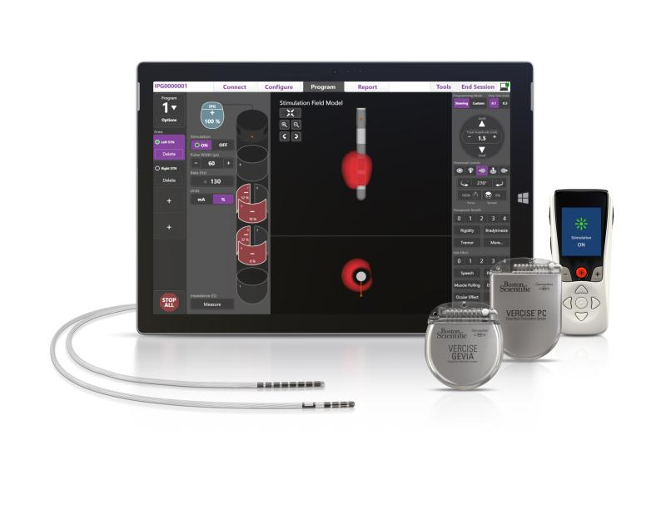
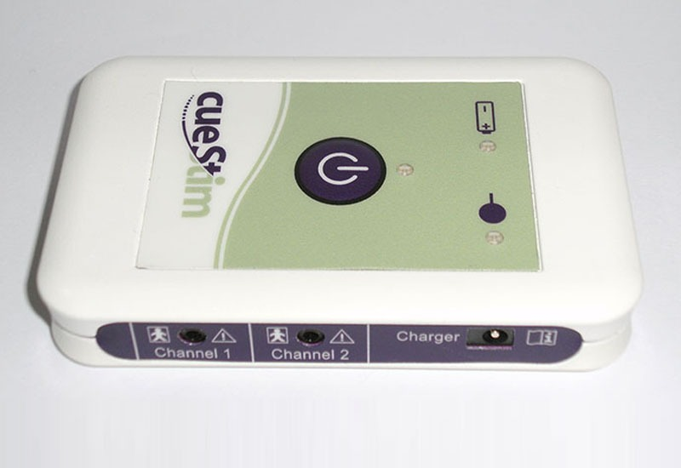
The cueStim system is a device worn around the waist that helps prevent Gait Freezing – which patients describe as feeling like their “feet are being glued to the ground” – by using electrical stimulation.
A new DBS model involves sending mild electrical stimulation to leads implanted in a targeted area of the brain, powered by an implantable pulse generator.
This FDA-approved device enable physicians to control the range, shape, position and direction of electrical stimulation to treat the symptoms of Parkinson’s disease.

